Slide 1




Suborbital Spaceflight: A student team’s plan to fly a rocket to space
Bryce Chanes
ChanesB@erau.edu
Mentor: Dr. Brenda Haven

Slide 2
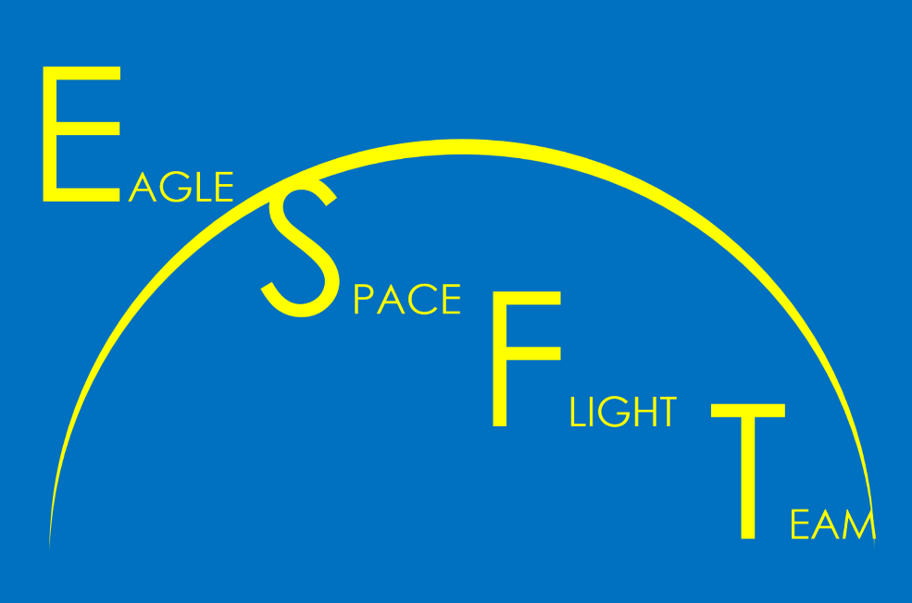
Outline
Program History
Program Goals
Previous Projects
Current System Development
Future Development

Slide 3
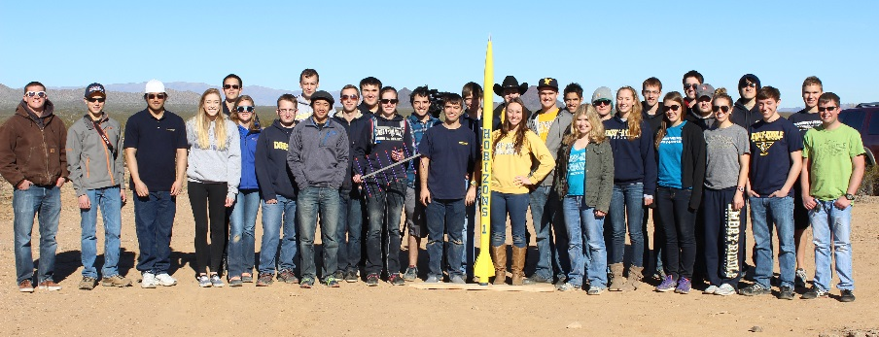
History
Founded in Fall 2015
45 students selected
First research grant awarded
Fast development of first vehicle
No technology advancement

Slide 4
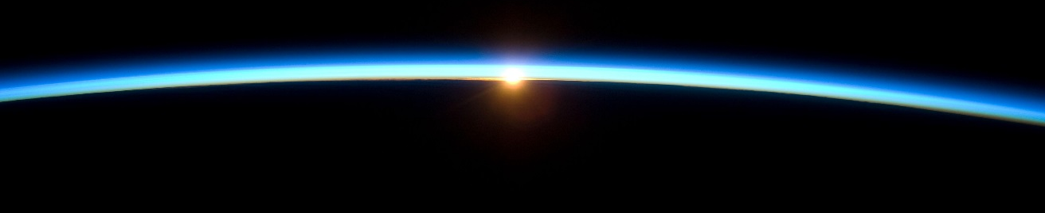
Eagle Space Flight Team
Develop a rocket capable of:
Reaching an apogee of over 100 km
Returning to Earth safely
High percentage reusability
Student designed and manufactured
10 kg payload capacity
nasa.gov

Slide 5
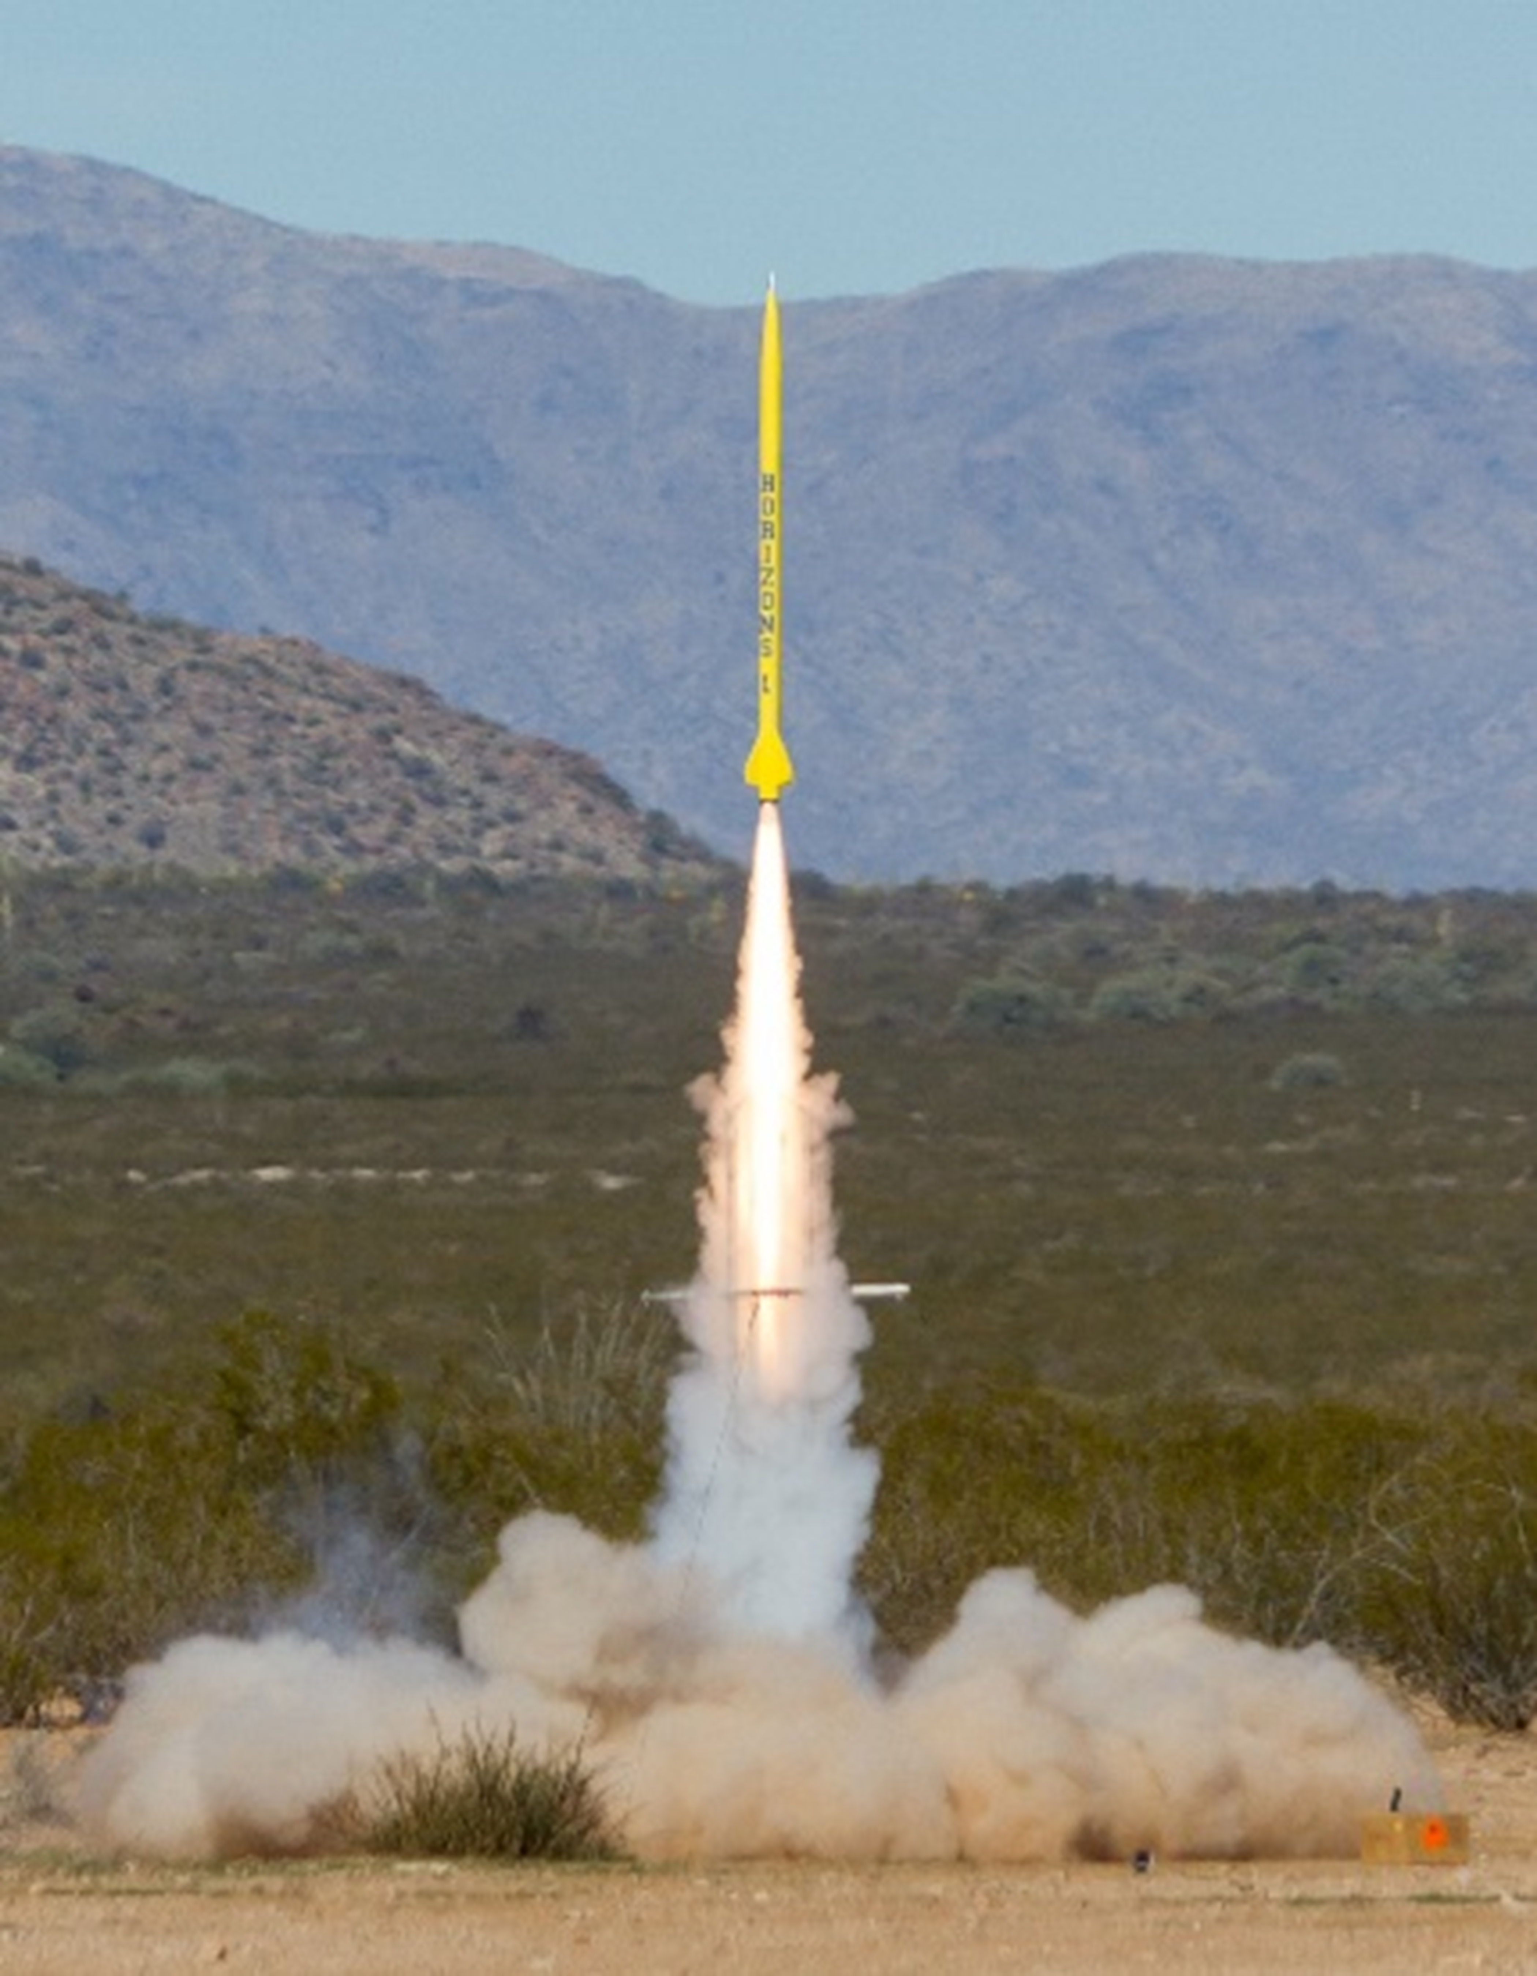
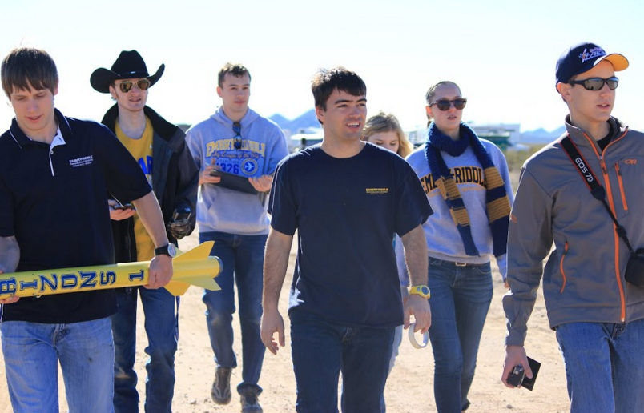
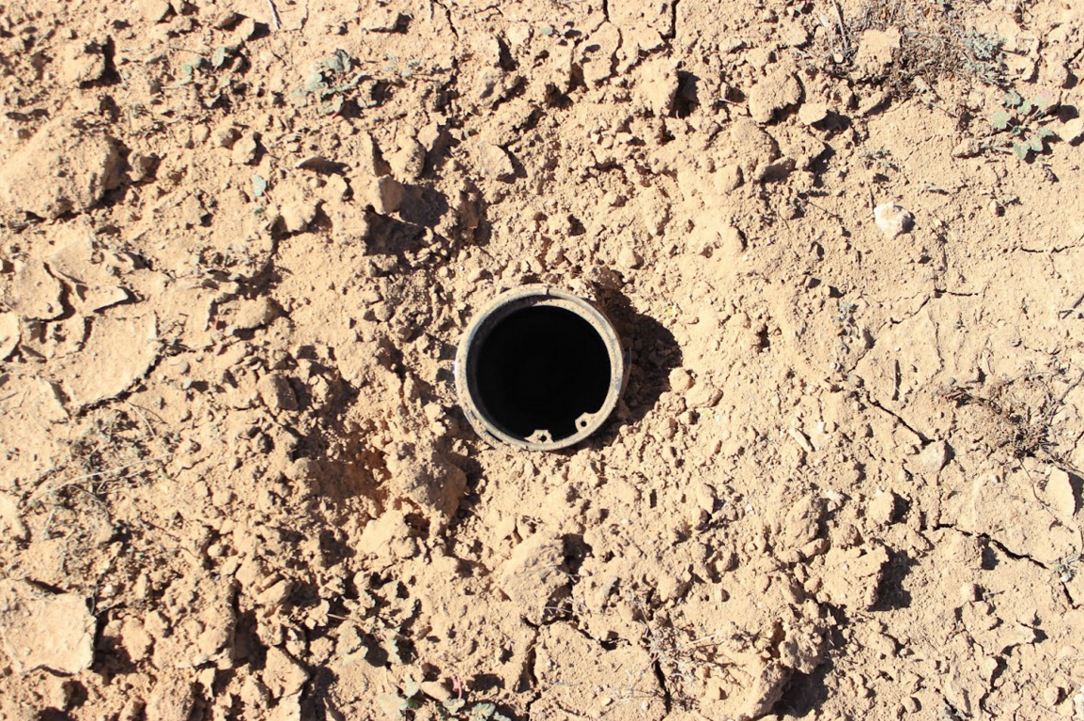
Horizons 1
Diameter = 3 in
Length = 6.8 ft
Maximum Altitude = 22,000 ft
Maximum Velocity = 2,472 ft/sec (Mach 2.2)
Final Altitude = -6.78 ft

Slide 6
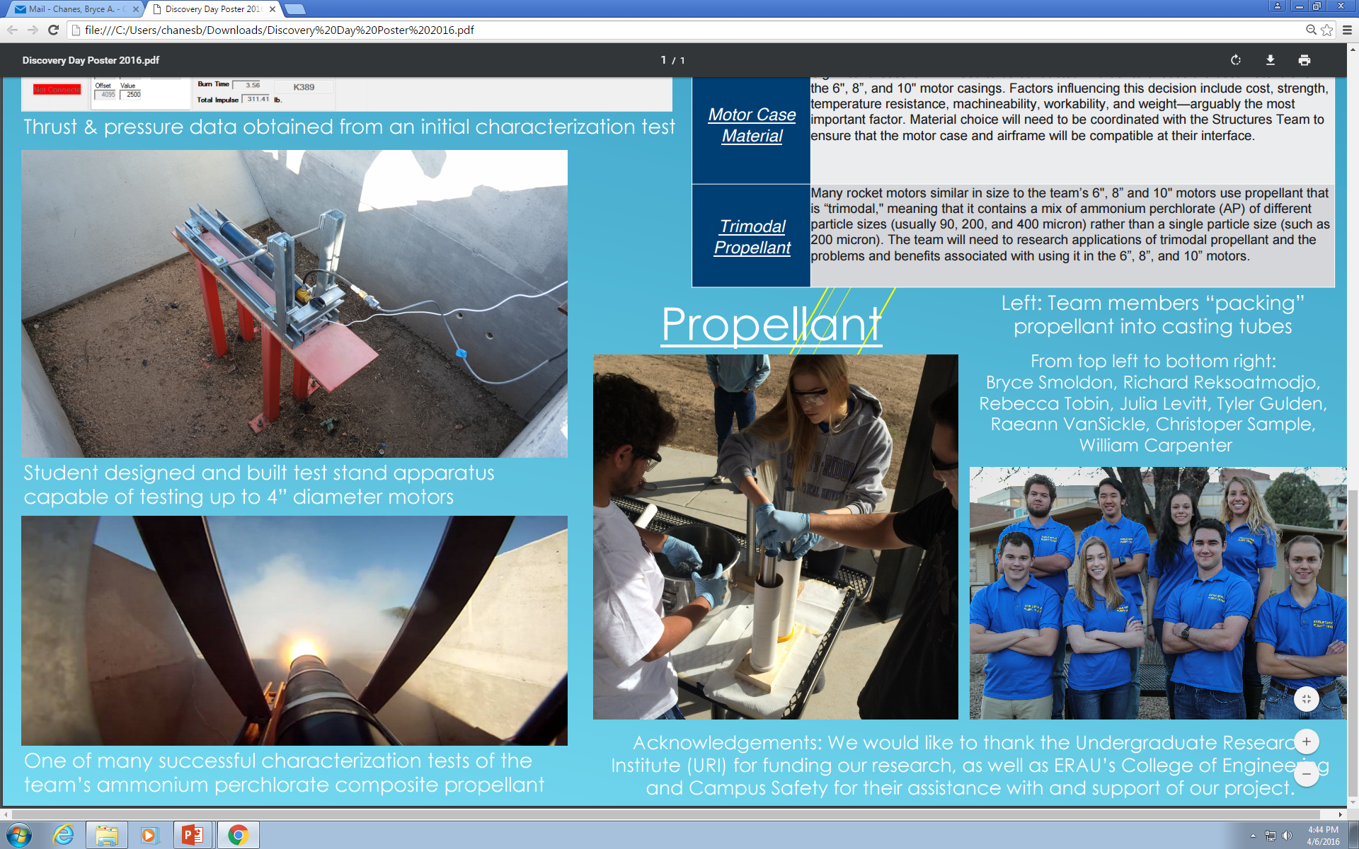
Propulsion Development
Solid Fuel
Limited budget
Long-burn
Student made and processed

Slide 7
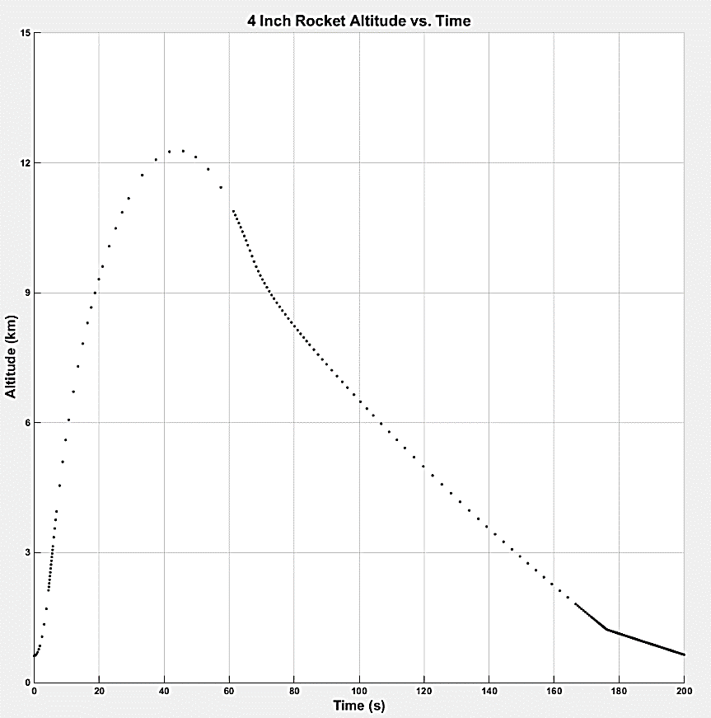
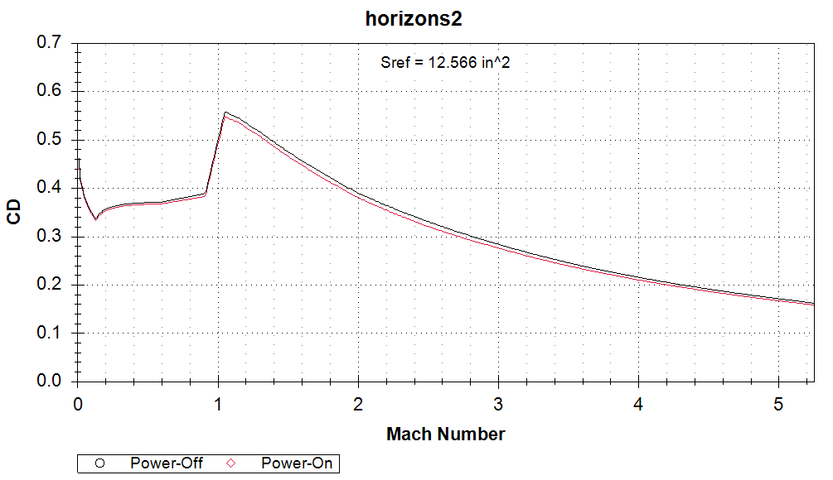
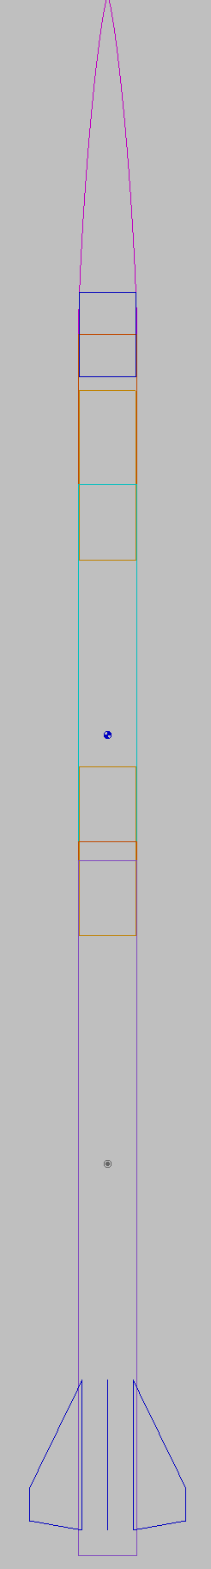
Structure and Aerodynamics
Comparative studies of current and past vehicles
Thermal and Aerodynamic interactions
Computer simulation of launch and descent trajectories

Slide 8
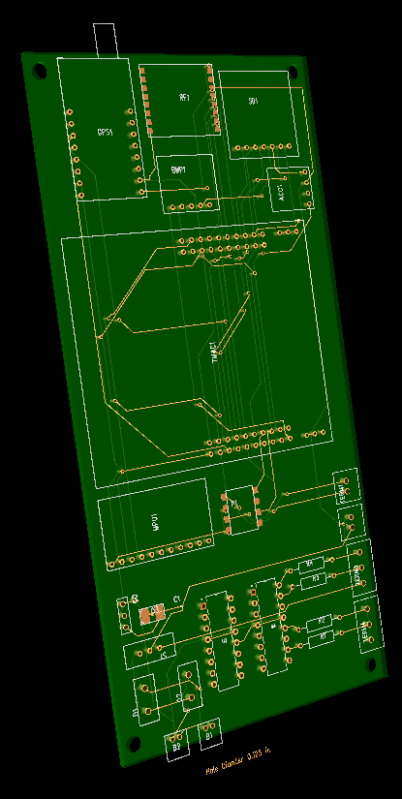
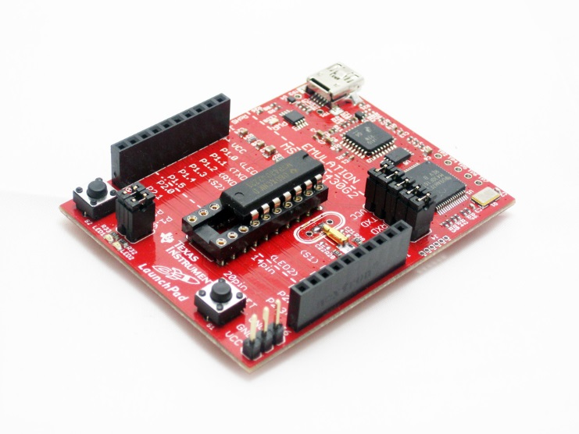
Recovery and Tracking
GPS telemetry throughout entire flight
Recovery device trigger
Flight data acquisition
Ground station for real-time data recovery
Fabacademy.org

Slide 9
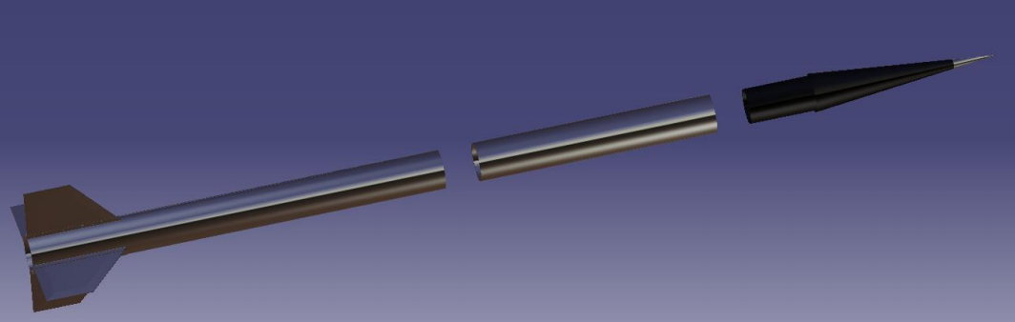
Current Project
Diameter = 4 in
Length = 73 in
Student made propulsion
Primary student built electronics

Slide 10
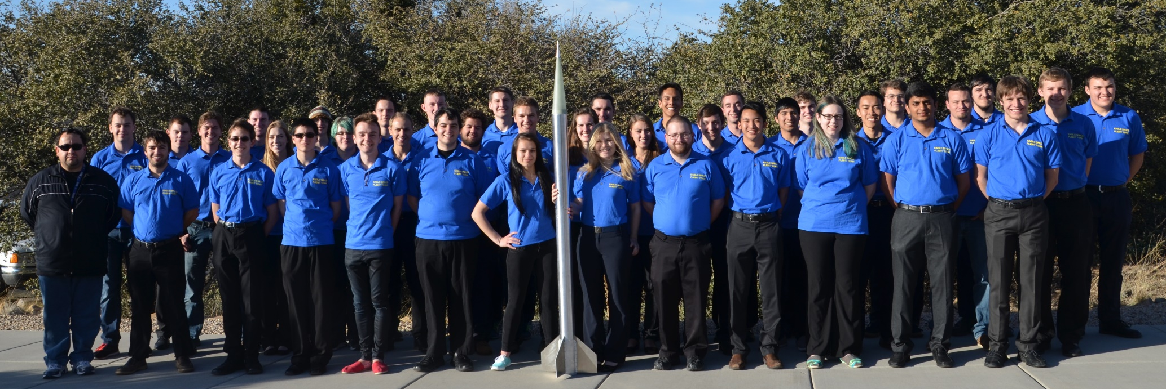
Future Development
Propulsion scaling
Subsystem maturity
Financial support
Subscale performance comparisons

Slide 11
Acknowledgements
Dr. Gary Yale – ERAU Space Grant Coordinator
Dr. Brenda Haven – Project Mentor
Dr. Julio Benavides – Project Mentor
Undergraduate Research Institute

Slide 12
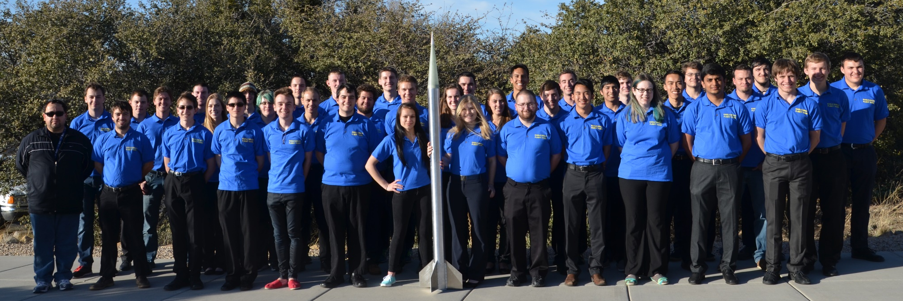
Questions?
Please read more about and contact us at:
www.EagleSpaceFlightTeam.com
www.facebook.com/eaglespaceft/
EagleSpaceFlightTeam@gmail.com

